Slide 1
RAG in ColdFusion
Building AI-Powered Knowledge Applications
Prashant Dubey
ColdFusion Engineering | Adobe
© 2026 Adobe. All Rights Reserved. Adobe Confidential.

Slide 2
Agenda
1. What is RAG?
2. Simple RAG
3. Providers & Vector Stores
4. Document Ingestion & Formats
5. Advanced RAG Pipeline
6. Guardrails
7. Document Service
8. Wrap-up
© 2026 Adobe. All Rights Reserved. Adobe Confidential.

Slide 3
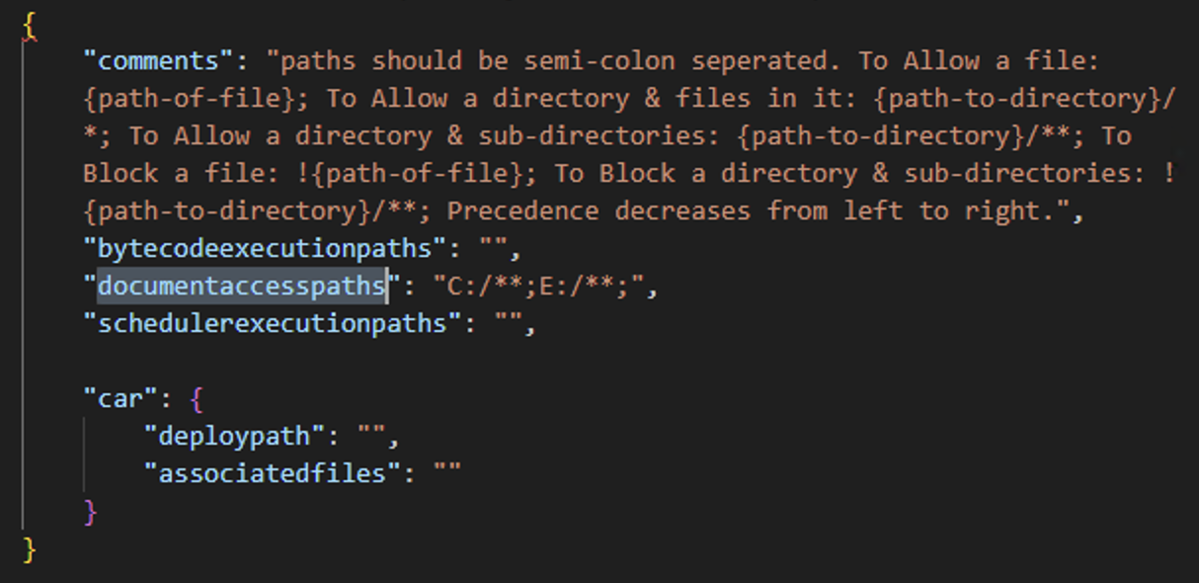
Before You Start — Whitelist Your Document Paths
ColdFusion’s file security controls which directories can be read by CFML. RAG ingestion needs read access to every folder you want to index — add them to pathfilter.json before running a demo.
Config file: <CF_HOME>/cfusion/lib/pathfilter.json
Add the absolute paths (or patterns) you intend to ingest:
“documentaccesspaths”: [“C:/**”, “E:/**”, “/Volumes/RAG/**”]
Keep it tight in production — only the folders the RAG job actually needs.
Restart ColdFusion after editing the file for changes to take effect.
© 2026 Adobe. All Rights Reserved. Adobe Confidential.

Slide 4
What is RAG?
• RAG = Retrieval-Augmented Generation
• A technique that lets LLMs answer questions using YOUR data:
◦ 1. You feed your documents into a vector store (one-time indexing)
◦ 2. When a user asks a question, the most relevant chunks are retrieved
◦ 3. Those chunks are injected into the LLM prompt as context
◦ 4. The LLM generates an answer grounded in your actual data
• Why it matters:
◦ LLMs don’t know your private data — RAG gives them access
◦ No retraining needed — update your docs, answers update automatically
◦ Reduces hallucinations — answers are backed by real documents
© 2026 Adobe. All Rights Reserved. Adobe Confidential.

Slide 5
How RAG Works
1
Your documents are split into chunks and converted to vectors (embeddings)
2
Vectors are stored in a vector database for fast similarity search
3
When a user asks a question, it’s also converted to a vector
4
The closest matching chunks are found and injected into the LLM prompt
Result: The LLM answers based on your actual documents, not guesswork.
© 2026 Adobe. All Rights Reserved. Adobe Confidential.

Slide 6
The Scenario
We’ll build a support bot that answers from company documents
• Documents we’ll use:
◦ Product docs — features, pricing, integrations, support options
◦ Employee handbook — leave policy, expenses, remote work rules
◦ FAQ — billing, password reset, data export, account management
• We’ll cover what RAG in ColdFusion gives you:
◦ Grounding answers in your own documents
◦ Fine-tuning how retrieval picks the right chunks
◦ Guardrails that inspect every request before it reaches the model
◦ Streaming ingestion for large document corpora
© 2026 Adobe. All Rights Reserved. Adobe Confidential.

Slide 7
Part 1: Simple RAG
Your first AI knowledge bot
© 2026 Adobe. All Rights Reserved. Adobe Confidential.

Slide 8
Why RAG — Ground the Model in Your Data
Without RAG the LLM only knows what was in its training data. It cannot answer from your product docs, handbook or FAQ. RAG solves that in three steps — ingest, retrieve, augment.
Customer: What are the pricing plans?
AI: I don’t have specific pricing information. Please check the company website. ✘ useless
Customer: What’s the leave policy?
AI: Typically companies offer 10-15 days depending on policy. ✘ generic guess
Customer: How do I export my data?
AI: Most applications let you export data from the settings menu. ✘ not your product
Solution: Feed your documents to the LLM using simpleRAG(). →
© 2026 Adobe. All Rights Reserved. Adobe Confidential.

Slide 9
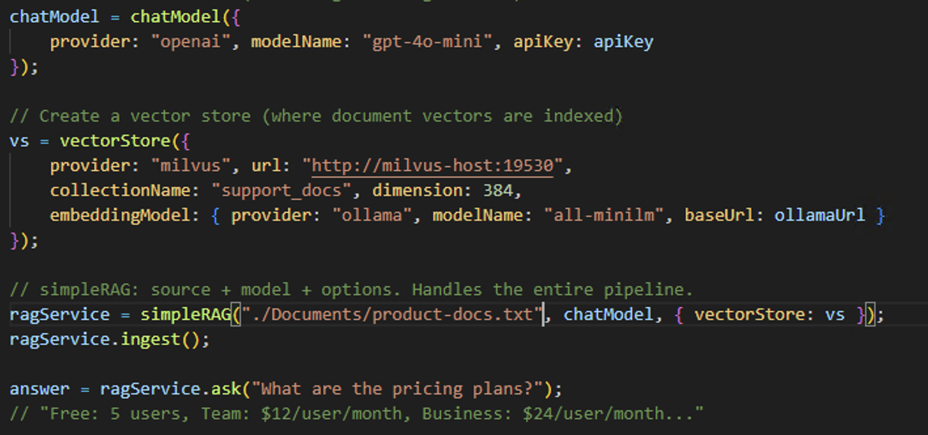
simpleRAG() — The Fastest Path to RAG
Create a chat model, a vector store, and pass them with your documents to simpleRAG().
It handles loading, splitting, embedding, storing, and retrieval automatically.
© 2026 Adobe. All Rights Reserved. Adobe Confidential.

Slide 10
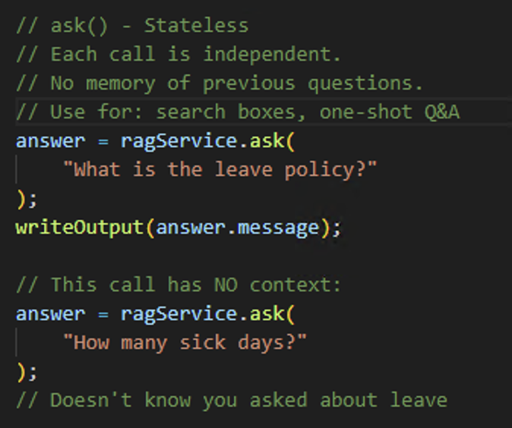
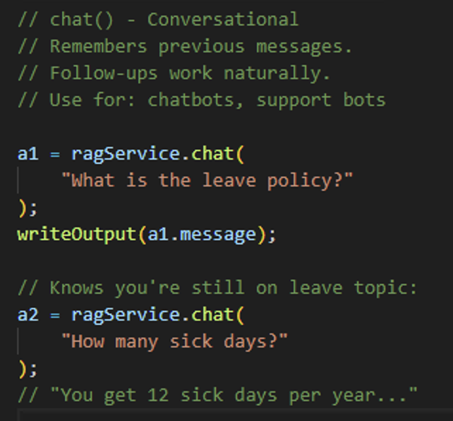
ask() vs chat()
ask() is stateless — each call is independent. chat() maintains conversation memory so follow-up questions work.
© 2026 Adobe. All Rights Reserved. Adobe Confidential.

Slide 11
Chunking — Why It Matters
LLMs cannot read an entire 10-page document for every question. Splitting turns each document into bite-sized chunks that can be embedded, searched, and sent to the model on demand.
Smaller chunks → sharper similarity matches, cheaper tokens, less noise per query.
Overlap preserves context across chunk boundaries so sentences aren’t cut mid-idea.
recursive —default: paragraphs → sentences → words. Great for mixed docs.
sentence — one sentence per chunk. Ideal for FAQs and QA-style data.
paragraph / line / word — for highly structured or very short inputs.
Pick chunkSize for your data: ~500 chars for narrative, ~200 for FAQ, ~1000 for contracts or code.
© 2026 Adobe. All Rights Reserved. Adobe Confidential.

Slide 12
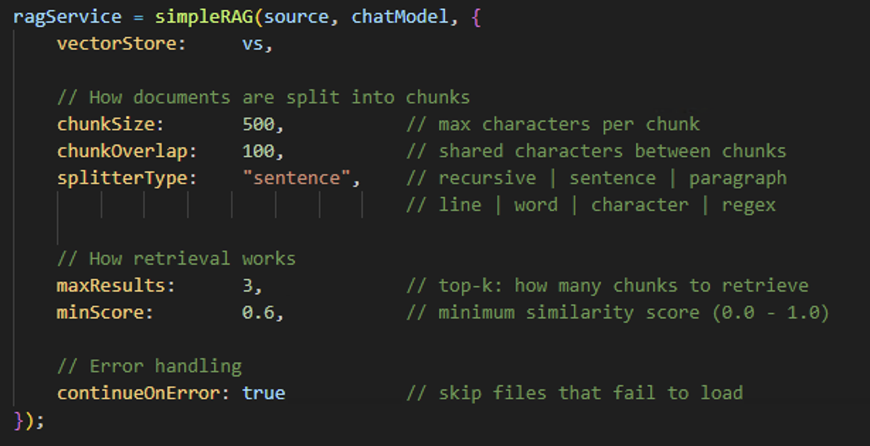
Simple RAG — Configuration
Tune how documents are split and how retrieval works. splitterType controls chunking strategy. maxResults and minScore control retrieval precision.
© 2026 Adobe. All Rights Reserved. Adobe Confidential.

Slide 13
Part 2: Providers & Vector Stores
© 2026 Adobe. All Rights Reserved. Adobe Confidential.

Slide 14
Supported Providers
• LLM Providers (chat / answer generation):
◦ OpenAI, Anthropic, Google Gemini, Azure OpenAI, Mistral, Ollama
• Embedding Providers (text → vectors):
◦ OpenAI, Azure OpenAI, Mistral, Gemini, Ollama
◦ Built-in InMemory (ONNX all-minilm, zero setup)
© 2026 Adobe. All Rights Reserved. Adobe Confidential.

Slide 15
Vector Stores
• InMemory: Built-in, zero setup. Data lost on server restart.
• Milvus
• Qdrant
• Chroma
• Pinecone
© 2026 Adobe. All Rights Reserved. Adobe Confidential.

Slide 16
Part 3: Document Ingestion & Formats
© 2026 Adobe. All Rights Reserved. Adobe Confidential.

Slide 17
Supported Formats
• Text: TXT, LOG, TSV
• Rich: PDF (page range), DOCX, DOC, XLS, XLSX, PPT, PPTX
• Markup: Markdown, HTML, XML, RTF, EPUB
• Data: CSV, JSON, JSONL, Properties
• Feeds: RSS, Atom
• Archives: ZIP, JAR, WAR, TAR, GZ, BZ2
• Remote: URL via HTTP/HTTPS with auth headers
© 2026 Adobe. All Rights Reserved. Adobe Confidential.

Slide 18
Loaders & Splitting
• Loaders:
◦ File system — single file or recursive directory with pattern filtering
◦ URL — HTTP/HTTPS with auth headers, connection/read timeouts
• Splitting strategies (7 types):
◦ recursive (default), sentence, paragraph, line, word, character, regex
• Parameters:
◦ chunkSize — max characters per chunk
◦ chunkOverlap — shared characters between consecutive chunks
© 2026 Adobe. All Rights Reserved. Adobe Confidential.

Slide 19
Part 4: Advanced RAG
Full control over every pipeline stage
© 2026 Adobe. All Rights Reserved. Adobe Confidential.

Slide 20
Advanced RAG — Take Control of Every Stage
simpleRAG() gets you started in minutes. When you need to tune chunking, routing, aggregation or prompts, agent() exposes every stage as a configurable building block.
Customer: What integrations are available?
AI: The platform supports various features including task management, file sharing, and integrations with third-party tools... ✘ vague
:
: The bot retrieved chunks about "features" instead of "integrations" specifically.
: It mixed FAQ content with product docs.
With agent() you control every stage of the RAG pipeline. →
© 2026 Adobe. All Rights Reserved. Adobe Confidential.

Slide 21
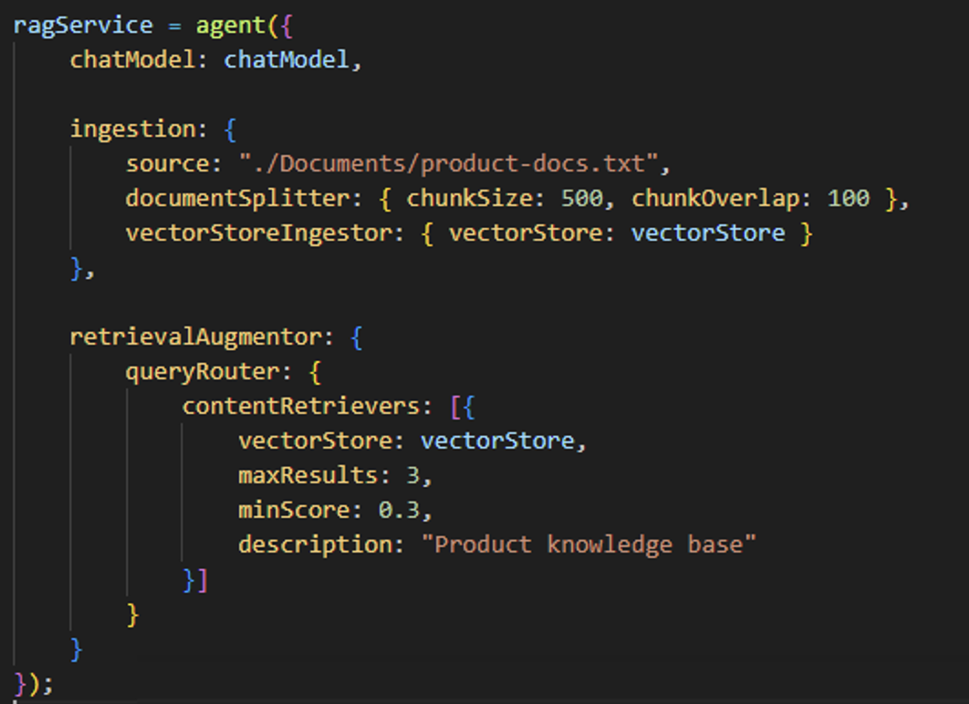
agent() — Full Pipeline Control
agent() lets you configure every stage: how documents are loaded, split, transformed, stored, and how queries are routed, retrieved,
and assembled into prompts.
© 2026 Adobe. All Rights Reserved. Adobe Confidential.

Slide 22
Ingestion Pipeline
5 configurable stages: Loader → Doc Transformer → Splitter → Segment Transformer → Ingestor
• Document Loader — File, directory (recursive + pattern), URL, custom UDF
• Document Transformer — UDF on each document BEFORE splitting (add metadata, clean HTML)
• Document Splitter — All 7 types with chunkSize + chunkOverlap
• Segment Transformer — UDF on each chunk AFTER splitting (tag, enrich, filter)
• Vector Store Ingestor — Embeds and stores chunks. batchSize (1-1000), continueOnError
© 2026 Adobe. All Rights Reserved. Adobe Confidential.

Slide 23
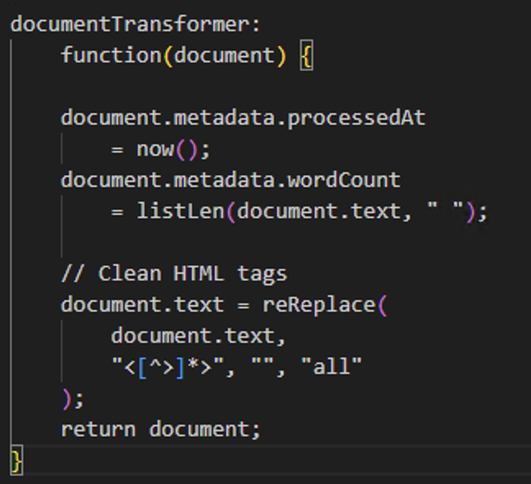
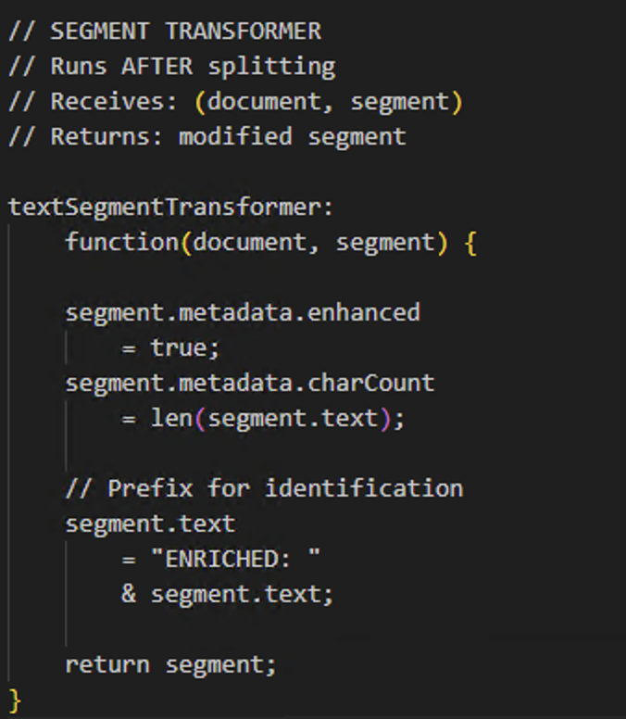
Transformers
Custom UDFs that enrich your data during ingestion. The document transformer runs before splitting; the segment transformer runs after.
© 2026 Adobe. All Rights Reserved. Adobe Confidential.

Slide 24
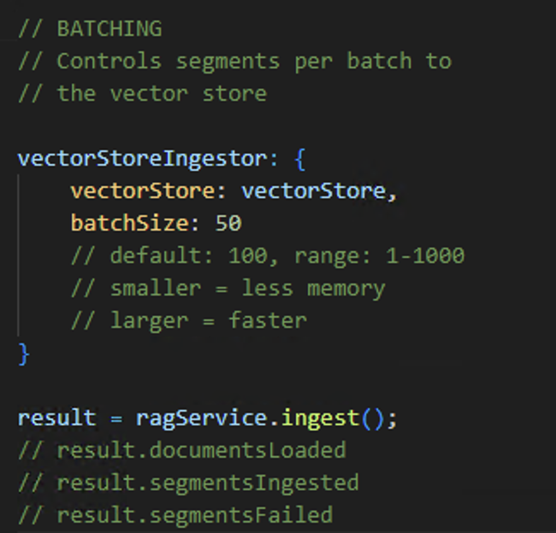
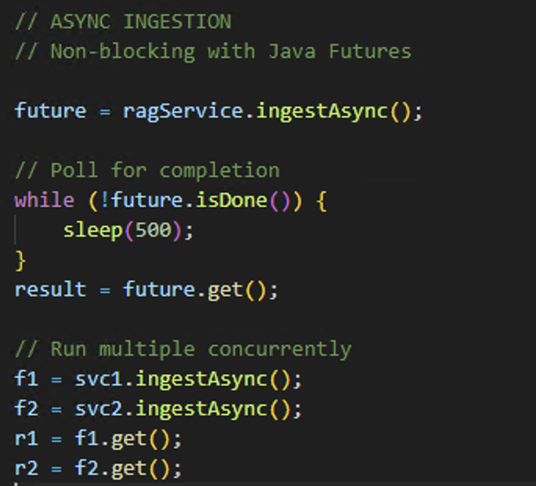
Batching & Async Ingestion
batchSize controls memory usage during ingestion. ingestAsync() makes ingestion non-blocking with Java Futures for background processing.
© 2026 Adobe. All Rights Reserved. Adobe Confidential.

Slide 25
Retrieval Pipeline
5 components: Query Transformer → Query Router → Content Retriever → Aggregator → Injector
• Query Transformer — Rewrites vague follow-ups into standalone queries
◦ Built-in: "compressing" type for multi-turn conversations
• Query Router — Routes to the right retriever(s)
◦ Default: sends to ALL | Intelligent: LLM picks best based on descriptions
• Content Retriever — Fetches relevant chunks. maxResults (top-k), minScore (threshold)
• Content Aggregator — Merges chunks from multiple retrievers with configurable separator
• Content Injector — Assembles the final prompt. {{contents}} + {{userMessage}} placeholders
◦ metadataKeys adds file info for citations
© 2026 Adobe. All Rights Reserved. Adobe Confidential.

Slide 26
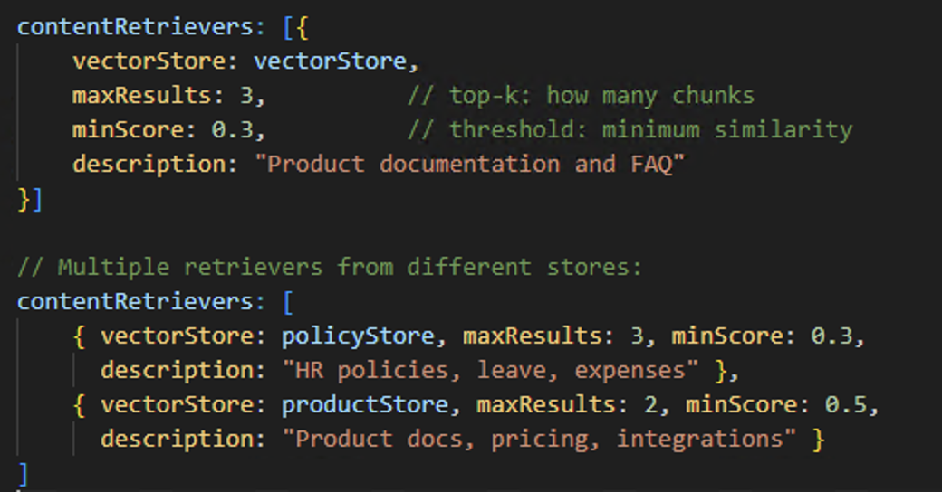
Content Retriever
maxResults controls how many chunks are returned. minScore filters out low-similarity matches. description helps intelligent routing decide
which retriever to use.
© 2026 Adobe. All Rights Reserved. Adobe Confidential.

Slide 27
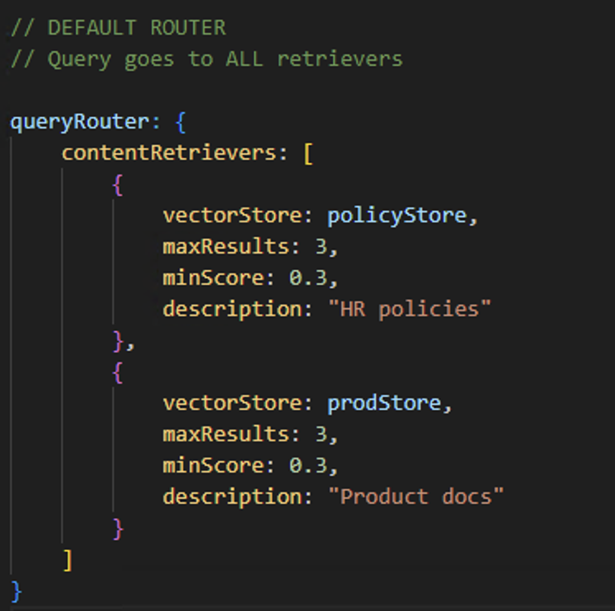
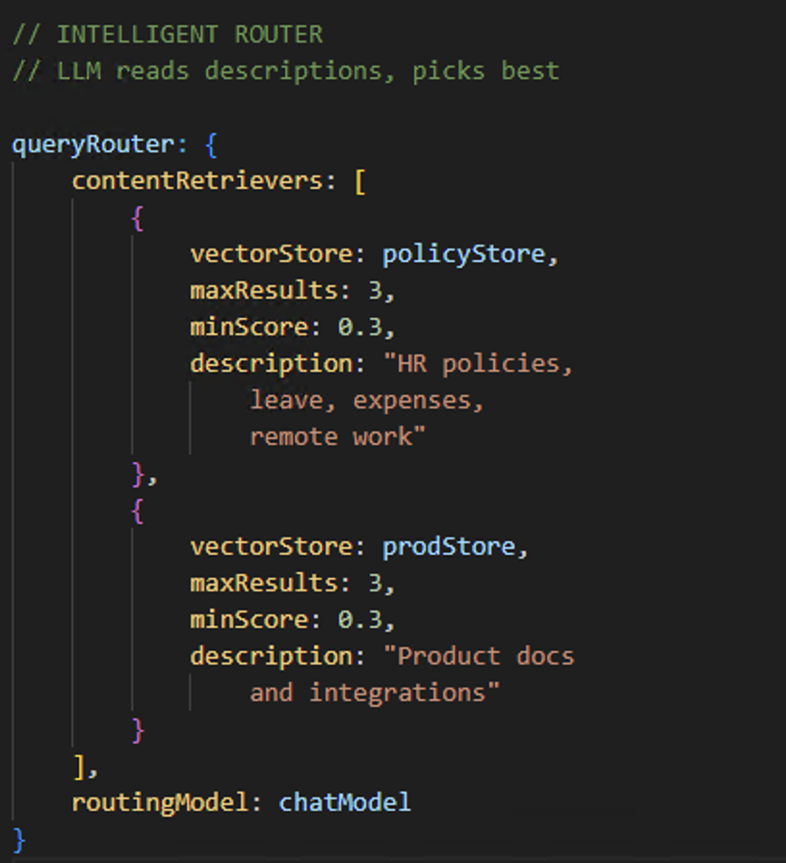
Query Routing
Default router sends every query to ALL retrievers.
Intelligent router uses the LLM to read descriptions and pick the best retriever, saving cost and reducing noise.
© 2026 Adobe. All Rights Reserved. Adobe Confidential.

Slide 28
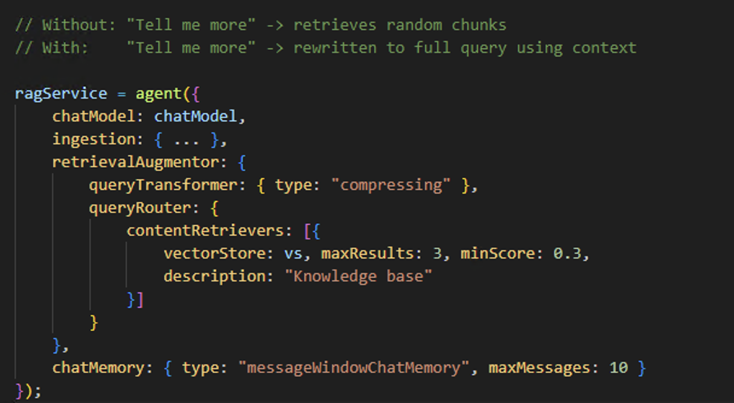
Query Transformer
The compressing transformer rewrites vague follow-ups like "tell me more" into full standalone queries,
so retrieval stays accurate across multi-turn conversations.
© 2026 Adobe. All Rights Reserved. Adobe Confidential.

Slide 29
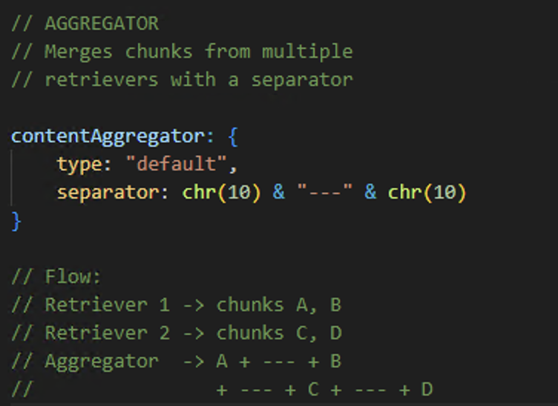
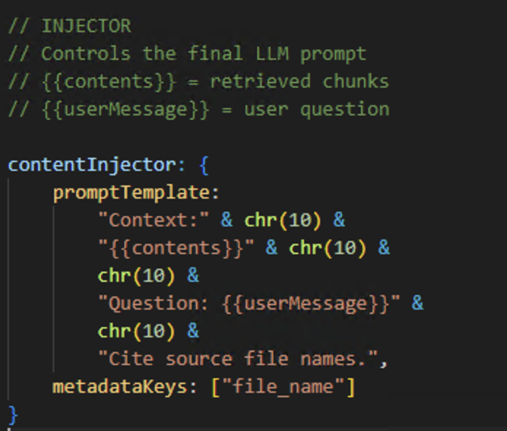
Content Aggregator & Injector
The aggregator merges chunks from multiple retrievers. The injector controls the exact prompt template sent to the LLM,
with placeholders for content and the user’s question.
© 2026 Adobe. All Rights Reserved. Adobe Confidential.

Slide 30
Part 5: Guardrails
© 2026 Adobe. All Rights Reserved. Adobe Confidential.

Slide 31
Why Guardrails — Sensitive Data in Messages
Chat inputs sometimes contain SSNs, credit card numbers or passwords. Guardrails inspect every message so that data never reaches the LLM.
Customer: My SSN is 123-45-6789, can you look up my account?
AI: I found your account! Your SSN 123-45-6789 is associated with... ✘ PII in response!
:
Customer: My credit card is 4111-1111-1111-1111
AI: I’ve noted your credit card number 4111-1111-1111-1111... ✘ stored PII!
Guardrails inspect every message before it reaches the model. →
© 2026 Adobe. All Rights Reserved. Adobe Confidential.

Slide 32
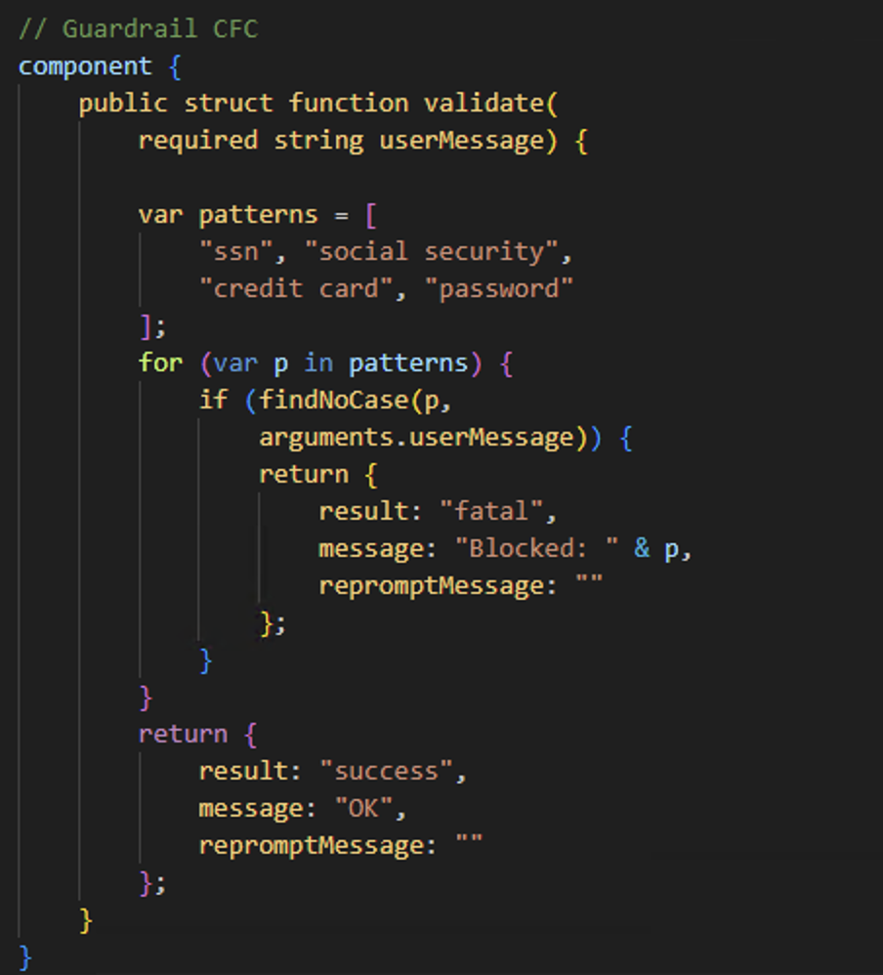
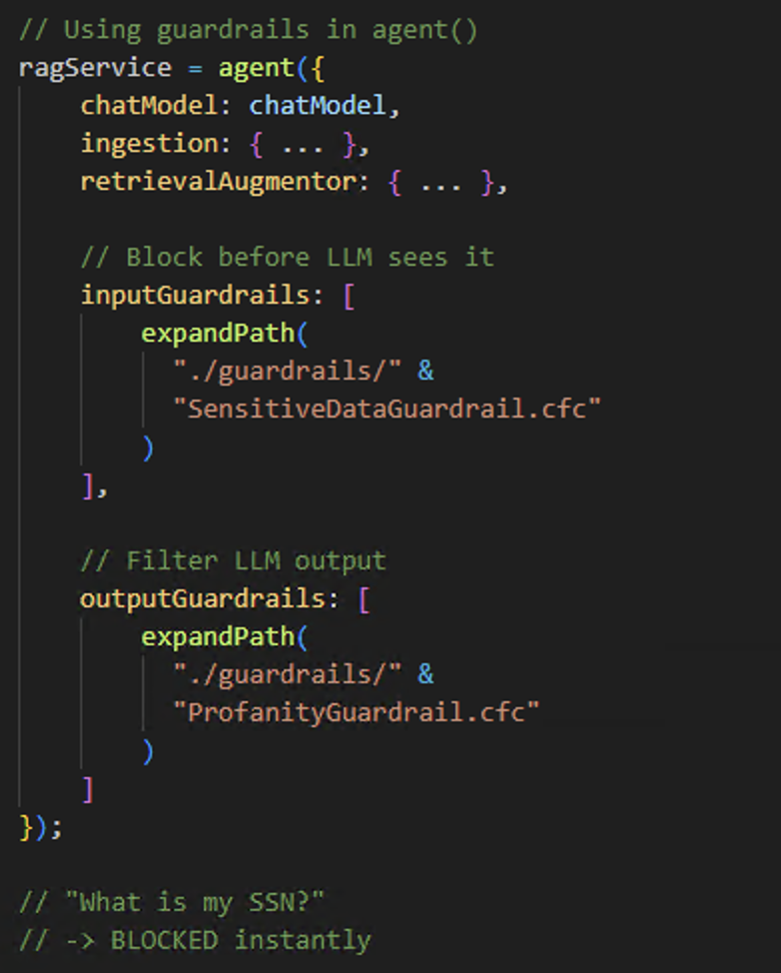
Guardrails — Input & Output Filters
Each guardrail is a CFC with validate(). It returns success, fatal (block), or reprompt (retry with new instruction). Multiple guardrails execute in order.
© 2026 Adobe. All Rights Reserved. Adobe Confidential.

Slide 33
Part 6: Document Processing Service
Standalone processing without an LLM
© 2026 Adobe. All Rights Reserved. Adobe Confidential.

Slide 34
documentService() — The Ingestion Toolkit
When you need to run ingestion as a scheduled job, share a vector store across services, or inspect intermediate data, documentService() gives you each stage as a standalone, chainable call.
load() • lazyLoad() — read files or folders into Document objects.
transform() — run your own CFML function on each Document before splitting.
split() — chunk documents with a chosen splitter type and chunk size.
transformSegments() — enrich each chunk with per-segment metadata.
ingest() • ingestAsync() — embed and push into the vector store, sync or non-blocking.
Composable with agent() — ingest via documentService, query via agent on the same store.
© 2026 Adobe. All Rights Reserved. Adobe Confidential.

Slide 35
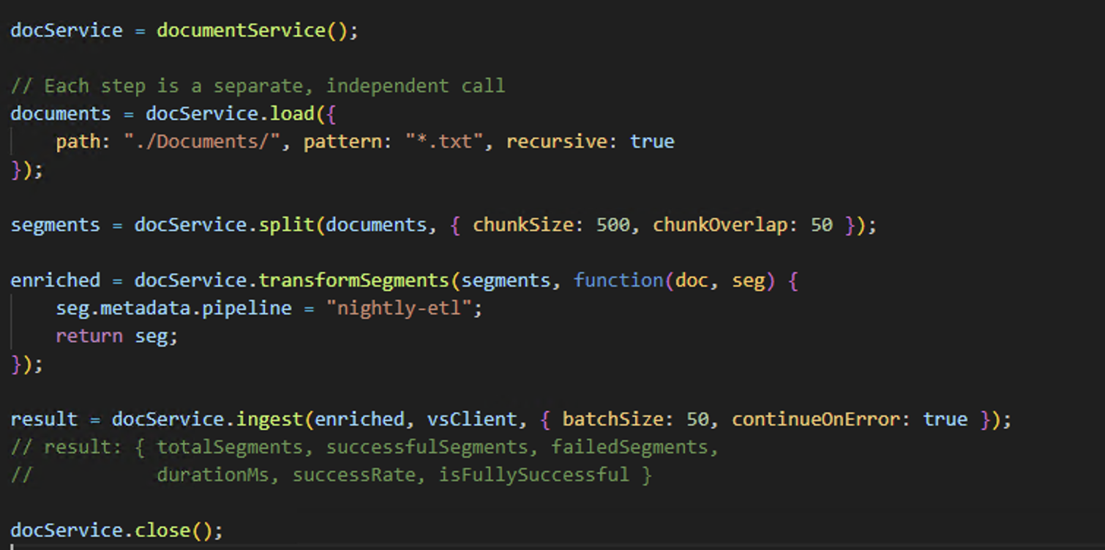
documentService()
Each step is independent: load, split, transform, ingest. Every method has an async variant.
No LLM involved — pure document processing for ETL jobs and shared infrastructure.
© 2026 Adobe. All Rights Reserved. Adobe Confidential.

Slide 36
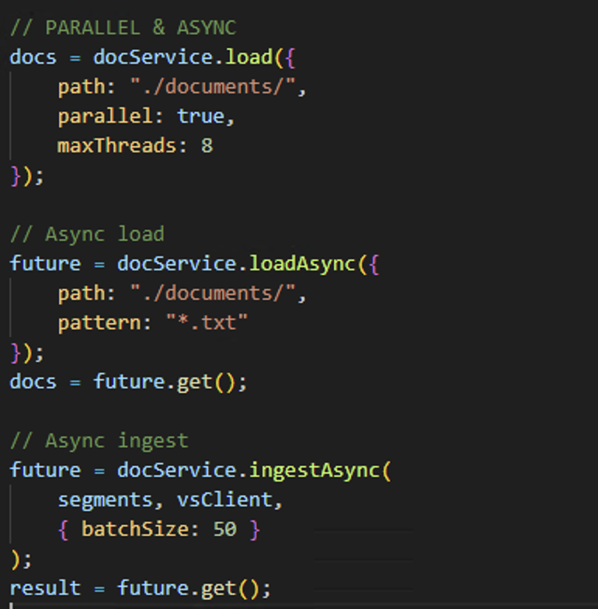
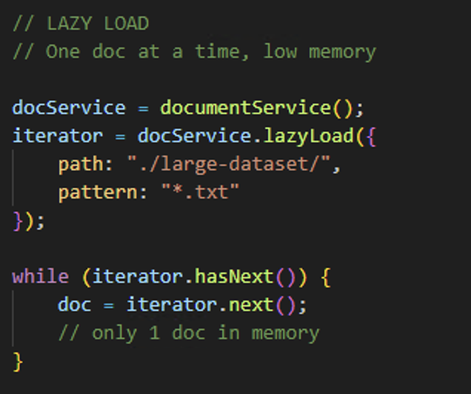
Lazy Load & Async methods
lazyLoad() streams one document at a time for large datasets. parallel: true enables multi-threaded loading.
Every method (load, transform, ingest) has an async variant returning a Future.
© 2026 Adobe. All Rights Reserved. Adobe Confidential.

Slide 37
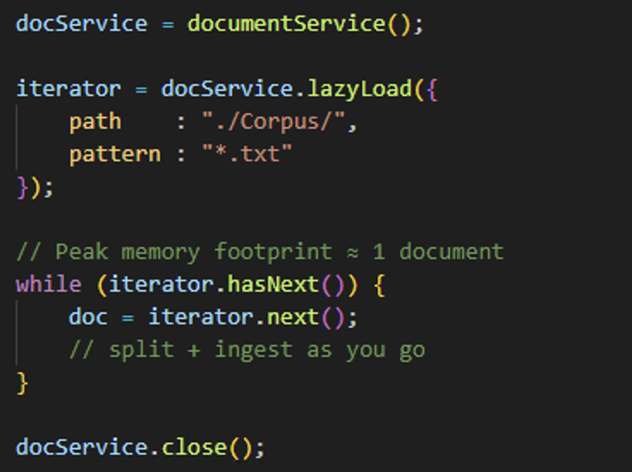
documentService().lazyLoad() — Stream Big Corpora
load() reads every file into memory before returning. For large archives that can exhaust JVM heap. lazyLoad() returns an iterator —
only one document is held at a time, processing can start before the whole set is loaded.
© 2026 Adobe. All Rights Reserved. Adobe Confidential.

Slide 38
Part 7: Wrap-up
© 2026 Adobe. All Rights Reserved. Adobe Confidential.

Slide 39
Admin UI
• RAG Ingestion UI in ColdFusion Administrator:
◦ /CFIDE/administrator/ai/rag/ingestion.cfm
◦ Single file, directory, and URL ingestion
◦ Async ingestion with status monitoring
◦ Authenticated access only
• Code Analyzer:
◦ Detects UDF name conflicts with RAG built-in functions
© 2026 Adobe. All Rights Reserved. Adobe Confidential.

Slide 40
Thank You
Prashant Dubey | ColdFusion Engineering | Adobe
© 2026 Adobe. All Rights Reserved. Adobe Confidential.

